Slide 1

HP SOLVE 2023 FINAL SUBMISSION
BY, Aibhinav Upadhyay
Email:- abhixsmasher@gmail.com

Slide 2
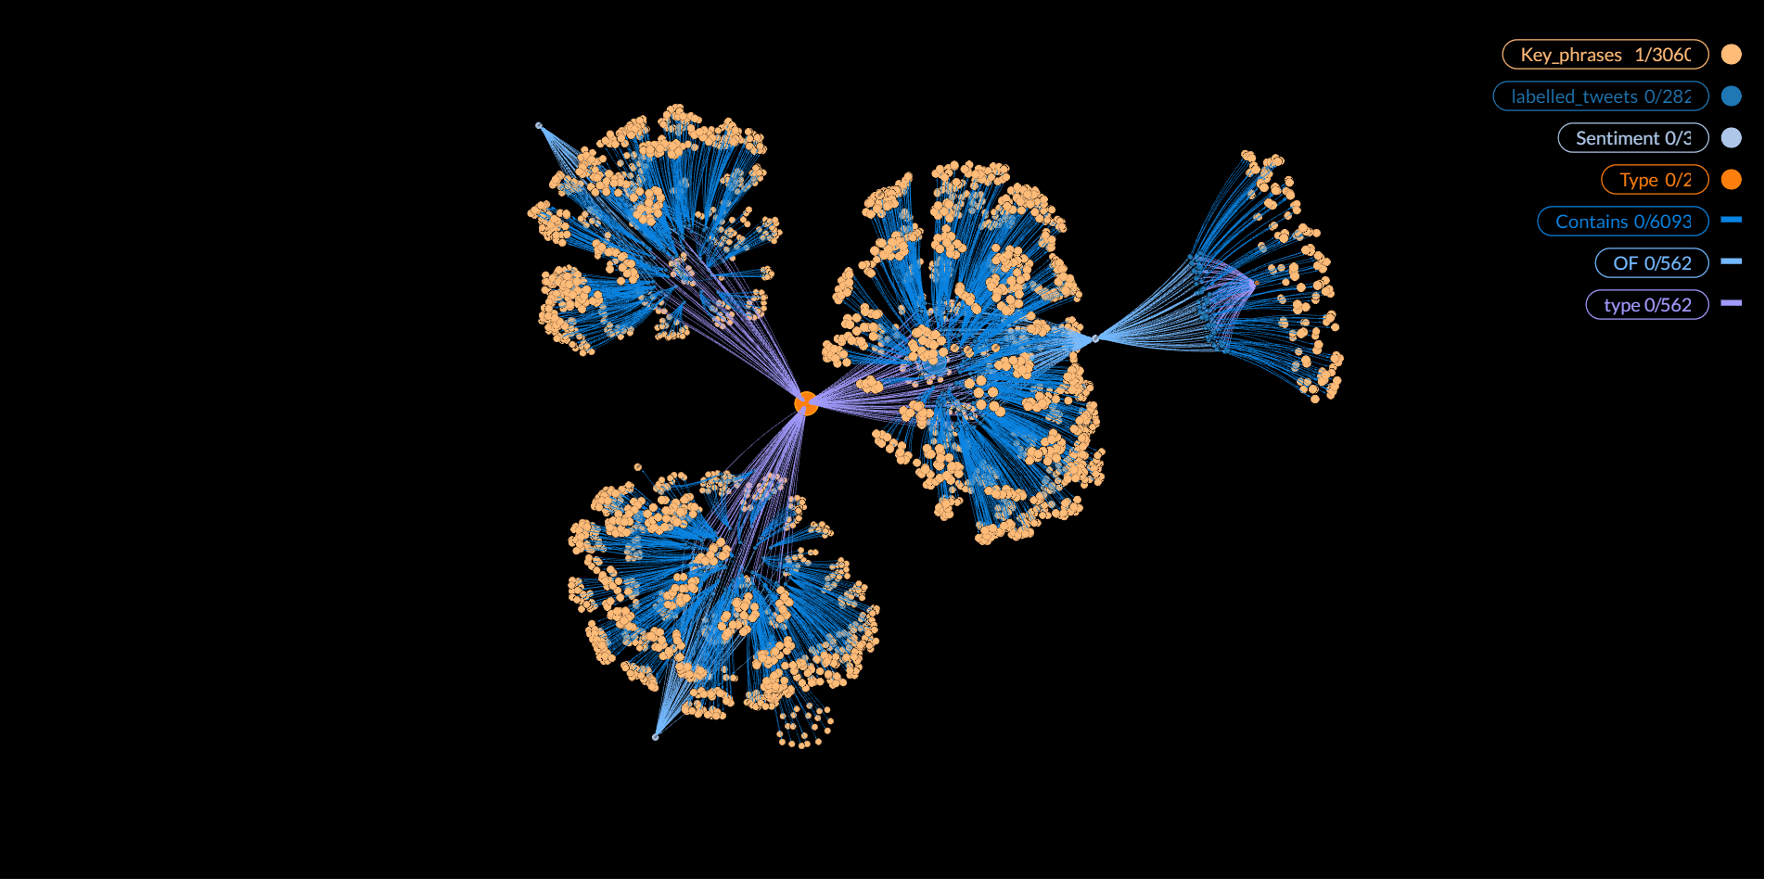



Overview of Problem Solution
Cleaned Data
Scraping of Social Media Data
Sites like twitter are scraped for data on a generic HP product .
NLP of the collected data
The collected data like tweets are preprocessed, cleaned and tokenized for further processing.
Sentiment Analysis and Key phrase generation
This stage will analyze the data for sentiments such as Complaint, Neutral or Appreciation and keywords are generated to find what the text talks about.
Queryable Knowledge Graph
The labelled data is converted into knowledge graph using Neo4j and GraphXR which can be queried using CYPHER language.
Knowledge Graph
Websites
Uncleaned Data
Labelled Data

Slide 3








High Level Design
Endpoint and Input
Web Scraping and NLP
Graph Conversion and Relationship Generation
Output Files and Graphs
Entering the product to collect data on
HTML Content of website is parsed after searching for product
Initializing Nodes of labelled data
Labelled Data
Extracting the necessary content and cleaning the text
Initializing a Web driver to search on website using Selenium
Initializing Nodes of Category and Types
Nodes Table/Relation
Analyzing the data for sentiments and extracting keywords
Signing in to websites and/or providing credentials
Building Relationships between the nodes
Knowledge Graph

Slide 4
Web Scraping
For the first step, we import the libraries into the Jupyter notebook and initialize a web driver using selenium. The web driver is then directed towards the intended page of the website (twitter in this case) and the user is asked to login with his/her credentials. This step is necessary as most social media websites have blocked or have paid incoming API requests.
Once completed, the search bar is passed with the product for which data is needed and, the scraping begins. The driver is automatically scrolled for the tweets that are saved to a list using the sleep function and data is then extracted from each tweet. For this we use the XML path of the HTML tags containing the content of the post.
We are then presented with the Username, Handle, likes, retweets, number of comments, and text of the tweet which can be stored to a .csv file.
Tech/Library Used | Function
Jupyter (Common for all stages) | Jupyter Notebook used as computing platform
Selenium | Initializing the web driver and searching products
time | For allowing the function sleep() to be used while scraping data

Slide 5
Sentiment Analysis
In the next step, the uncleaned data is converted into cleaned data. The NA values are converted to zero using pandas and the text is converted to lexicon and tokens with the stop words being removed.
VaderSentiment a library which performs sentiment analysis on a given string by assigning a score to every lexicon, is used. Upon its operation we are presented with a dictionary of scores , i.e. :- positive, negative, neutral and compound with values ranging from -1 to 1. This way seems fit as we have unsupervised model to be clustered.
By rule forming with the scores, we can assign a label to every tweet, and is saved to the tweets dataframe with the help of pandas. The number of sentiments can be increased and decreased and cross checked on a testing data with hyperparameter tuning and the net accuracy can be increased.
Tech/Library Used | Function
pandas | Fill NA values and work with dataframes
nltk | Importing Stop words, English corpus and tokenizing
VaderSentiment | Sentiment Analysis of a string by a score attained on lexicon basis

Slide 6
KeyPhrase Generation
For generating which product the post talks about and what features it mentions, we can use keyword/keyphrase generation. For this we shall be using yake library to perform both the tasks in one go.
In this each extracted keyphrase is assigned a score based on how important it is deemed by the unsupervised model. Thus, as long as keyphrases exist in the text they can be extracted. For this model we shall be extracting the top 20 phrases, but this can be increased as deemed necessary by the developer to generate more information from the post by sacrificing on the fact that some keyphrases may not be useful.
Finally, as we have a list of keyphrases, to store it into the dataframe can be tricky, for which we first assign a column of list and then insert the lists of keyphrases generated. Now we have our completely labelled data with their keyphrases and we can move to creation of knowledge graph.
Tech/Library Used | Function
yake | Generate Keywords and phrases from a sentence by using a light-weight unsupervised automatic keyword extraction method
pandas | Store Key phrases as a list of strings into the database and store as labelled tweets

Slide 7
Knowledge Graph Conversion
The dataframe with the data is now converted to a knowledge graph. For this we shall be using neo4j a free and native graph database. The desktop version is used and is linked to the jupyter notebook using its associated library.
The nodes are loaded into the database using cypher queries which are also used to create nodes of types – replies and original, and of the sentiments to which the data has been categorised with their associated relationships.
The GraphXR plugin is installed and is used in the Neo4j desktop to extract the list of keyphrases associated with the individual nodes into separate nodes and link them to their associated post.
The built knowledge graph is visualized using GraphXR and the nodes are changed to appropriate color and placement in a 3d space. The complete data of nodes and relationship is stored into .csv files also.
Tech/Library Used | Function
Neo4j | Building the labelled tweets into Nodes and run CYPHER queries to build relationship
GraphXR | Extracting Key Phrases as separate nodes with relationships and visualizing the knowledge graph

Slide 8
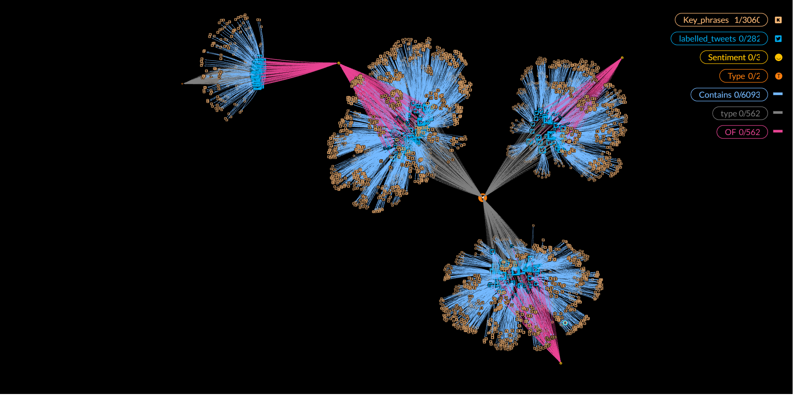
Result and Conclusion
By following the fore mentioned steps we are able to generate the given knowledge graph.
This graph consists of :-
- Data of tweets (Sea blue twitter nodes)
- Type of tweets, i.e. Replies and original(Nodes in orange connected with grey)
- Sentiments of Complaint, Appreciation and Neutral (Connected to nodes in pink)
- Key phrases attached to respective tweet
(Connected to tweets in light blue)
This graph can be queried in GraphXR using CYPHER to obtain appropriate results.
Thus, an end to end solution to collect social media data on given products and obtaining a queriable knowledge graph is complete.
KNOWLEDGE GRAPH OF TWEETS ON HP PRINTERS

Slide 9

About Me
Hi, I am Aibhinav Upadhyay, currently pursuing my B.Tech. in Computer Science and Engineering and am in my 3rd year at Netaji Subhas University of Technology.
I am deeply interested in ML models, Natural Language Processing and Data Analytics and currently an Intern at Samsung Research Institute-Bangalore(SRIB).
I was presented the opportunity of competing with some of the brightest minds of India in HP Solve 2.0 and have tried my very best to come up with an optimum and user friendly solution which is reliable, precise and efficient.
Name:- Aibhinav Upadhyay
Email and LinkedIn:- upadhyayaibhinav@gmail.com, Aibhinav Upadhyay
College:- Netaji Subhas University of Technology, Delhi
Stream:- B.Tech. in Computer Science and Engineering

